Slide 1
Fading Away: Historical Murals in Downtown Ellensburg
Amy McCoy & Mathew Novak
Department of Geography
Central Washington University

Slide 2
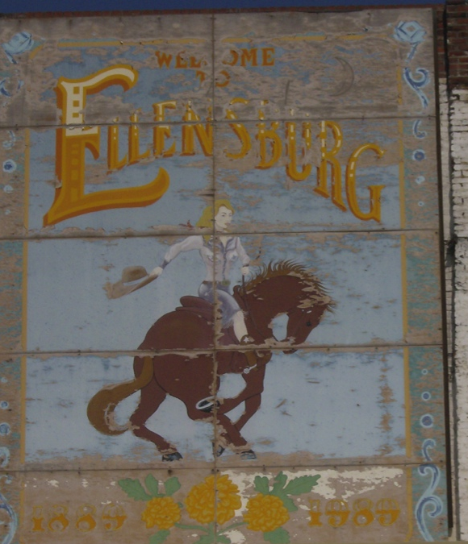
Outline
What is a mural
Compiling a mural inventory
Use of inventory in management
Notes:
During my presentation, we will be going over
What a mural is
How I compiled a mural inventory
How database is used in management

Slide 3
Definition of a Mural
Ellensburg Art Committee and the Landmark Design Committee’s joint language states:
15.13130 M Definition:
“A Mural is a singular work of visual art, which may contain graphics or text, painted or otherwise applied or attached on a building, structure, fence, or other object within public view.”
Notes:
Definition of a mural

Slide 4
What is a historic mural?
15.13.080 M Definition:
“A ‘historic mural’ is a mural that was originally created more than 50 years before the current date and that has been or will be inventoried and identified by the landmarks and design commission according to the process set forth in 15.28.080 for designating properties to the Ellensburg landmarks register. An historic mural, as defined herein, may contain advertising which promotes a business that is still in existence.”
Notes:
Definition of a historic mural.
Mural older than 50 years

Slide 5
Murals
Pre-billboard advertisements
Local businesses
Typically merchants and hotels
Some national products
Coca-Cola
Tobacco
Notes:
What murals were used for
How they compare to today’s uses

Slide 6
Downtown Revitalization
Downtowns have generally suffered since end of WWII
Competition from suburban shopping centers
Many programs to help revitalize
Capitalize on heritage
Distinctiveness & sense of place
Notes:
Main street downtowns have been struggling since the invention of strip malls and shopping centers
-small mom and pop stores can’t compete against large corporation discount stores
Programs are in place to help spark retail business in downtown areas.
Many downtowns capitalize on nostalgia

Slide 7
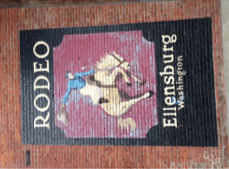
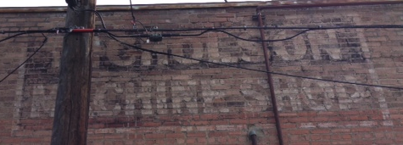
Methods
Study Area
Field Work – Summer 2013
Archival Work – Fall 2013
Notes:
My study are encompassed a specific area
Field work involved charting, documentation based on visual observation, and picture taking
Archival work was spent at the local library and on the CWU campus reviewing historic newspapers, articles, and building histories

Slide 8
Map of Study Area
Notes:
Taken from google earth….
Size

Slide 9
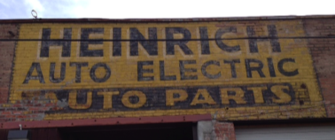
Compiling the Database
Variables recorded
Name of Building and if the building is Nationally Registered
Physical Location of the building
Size of Mural (S,M,L)
Location of Mural on Building
Direction Mural is Facing (N, S, W, E)
Date of renewal or restoration (if applicable)
Condition (Fair, Good, Poor)
Directly Painted or Attached to building via another surface
Prior Art underneath
Artist
Description of the Mural
Notes:
My variables include:

Slide 10
How The Murals were Classified
Historic: Created 50 years or older
Restored (historic): Original mural restored
Non-Historic/Other: Created under 50 years old, Works of art or business signs that are non-historic
Unknown: Authenticity or age that are not determined
Notes:
Once the data was collected, they had to be classified

Slide 11
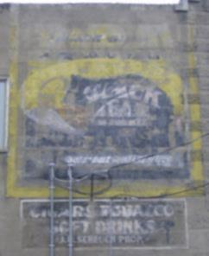
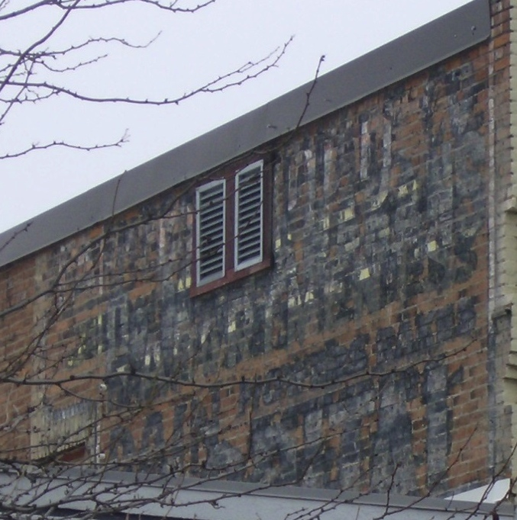
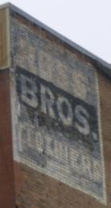
Examples of Historical Murals
Notes:
Newer, but older than 50
Technology and modernization
Note the adaptations made to accommodate electrical needs

Slide 12
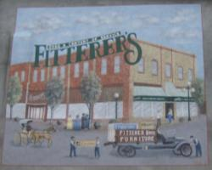
Examples of New Murals
Notes:
New murals blending in with restored murals.
Murals that don’t qualify due to the age of business.
Politics, Politics, Politics.

Slide 13
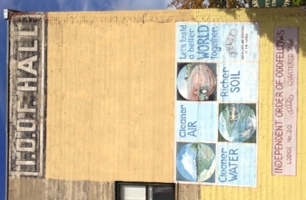
Perils of time
Weather
Previous modernization regimes
Whitewashing
Façade covering (stucco, metal)
Building destruction (fires/demolition)
New buildings covering old
Notes:
Keeping it real

Slide 14
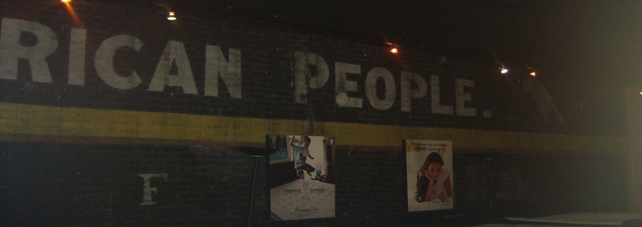
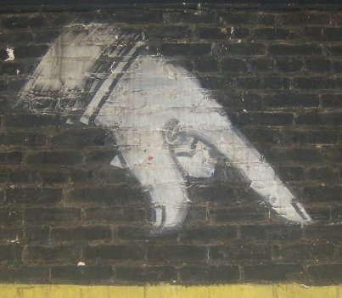
Murals caught in space and time
Fitterer’s Furniture and D&M Coffee Shop
Notes:
Indoor murals

Slide 15
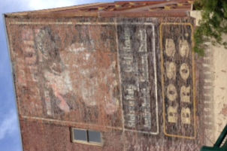
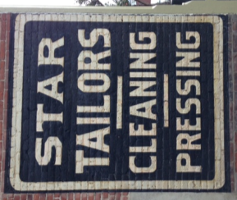
Management Strategies
Let fade
Re-touch
Repaint
New
Notes:
Options to maintain murals

Slide 16
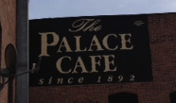
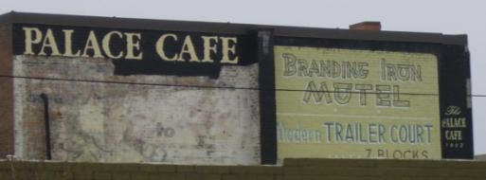
Database Utility
Document local history
Management for the future
Help with revitalization efforts
Influence local codes/ordinances
Notes:
How we use the information I collected.
Control invasive mural species.

Slide 17
Benefits of Murals
Tangible link to the past
Add to sense of place and distinctiveness of the downtown
Thus attracting people & businesses
However, not all murals are authentic
Often the public does not know which are which
Does authenticity matter?
Notes:
What makes murals an important part of the urban landscape?
French Human Geographer, Vidal de la Blache, is quoted as saying “a landscape is that to a medal cast in the image of its people”. This is very true in regards to historic murals.
Geographers John A. Matthews and David T. Herbert state “the record of people’s occupance of the land over long periods of time could be read from the study of landscape”. Such is also true for murals on historic buildings providing living history for the passerby” in their co-authored book, Geography.

Slide 18
Next Steps
Determine historical legitimacy of the murals
Public survey asking:
Impressions of murals
Ability to distinguish new versus old
Management strategies
Notes:
What needs to be done. We need to separate truly historic murals from the murals of historic images. Public opinion could be useful in able to determine whether or not the difference matters and if so, how to further manage authenticity.

Slide 19
Acknowledgements
Downtown Ellensburg Association
Landmarks & Design Commission
Ellensburg Public Library
David Wheeler, Carolyn Honeycutt
The CWU Geography Department

Slide 20
Questions?

